Slide 1
Physics
for
computer science

Slide 2
1- The motion of a body under the influence of gravity is subject to the following relationship:(V_{f} = V_{i} + gt) where g is the acceleration due to gravity, t is time, V_{f} is the final velocity, and Vi is the initial velocity.
Prove the validity of this relationship using dimensional equations
2- If a liquid is placed in a vertical tube, find the pressure of this liquid, given the height of the liquid in the tube, the density of the liquid, and the acceleration due to gravity.

Slide 3
Oscillations
Periodic & Oscillatory Motion:
The motion in which repeats after a regular interval of time is called periodic motion.
1. The periodic motion in which there is existence of a restoring force and the body moves along the same path to and fro about a definite point called equilibrium position/mean position, is called oscillatory motion.
2. In all type of oscillatory motion one thing is common i.e each body performing oscillatory motion) is subjected to a restoring force that Increases with increase in displacement from mean position.

Slide 4
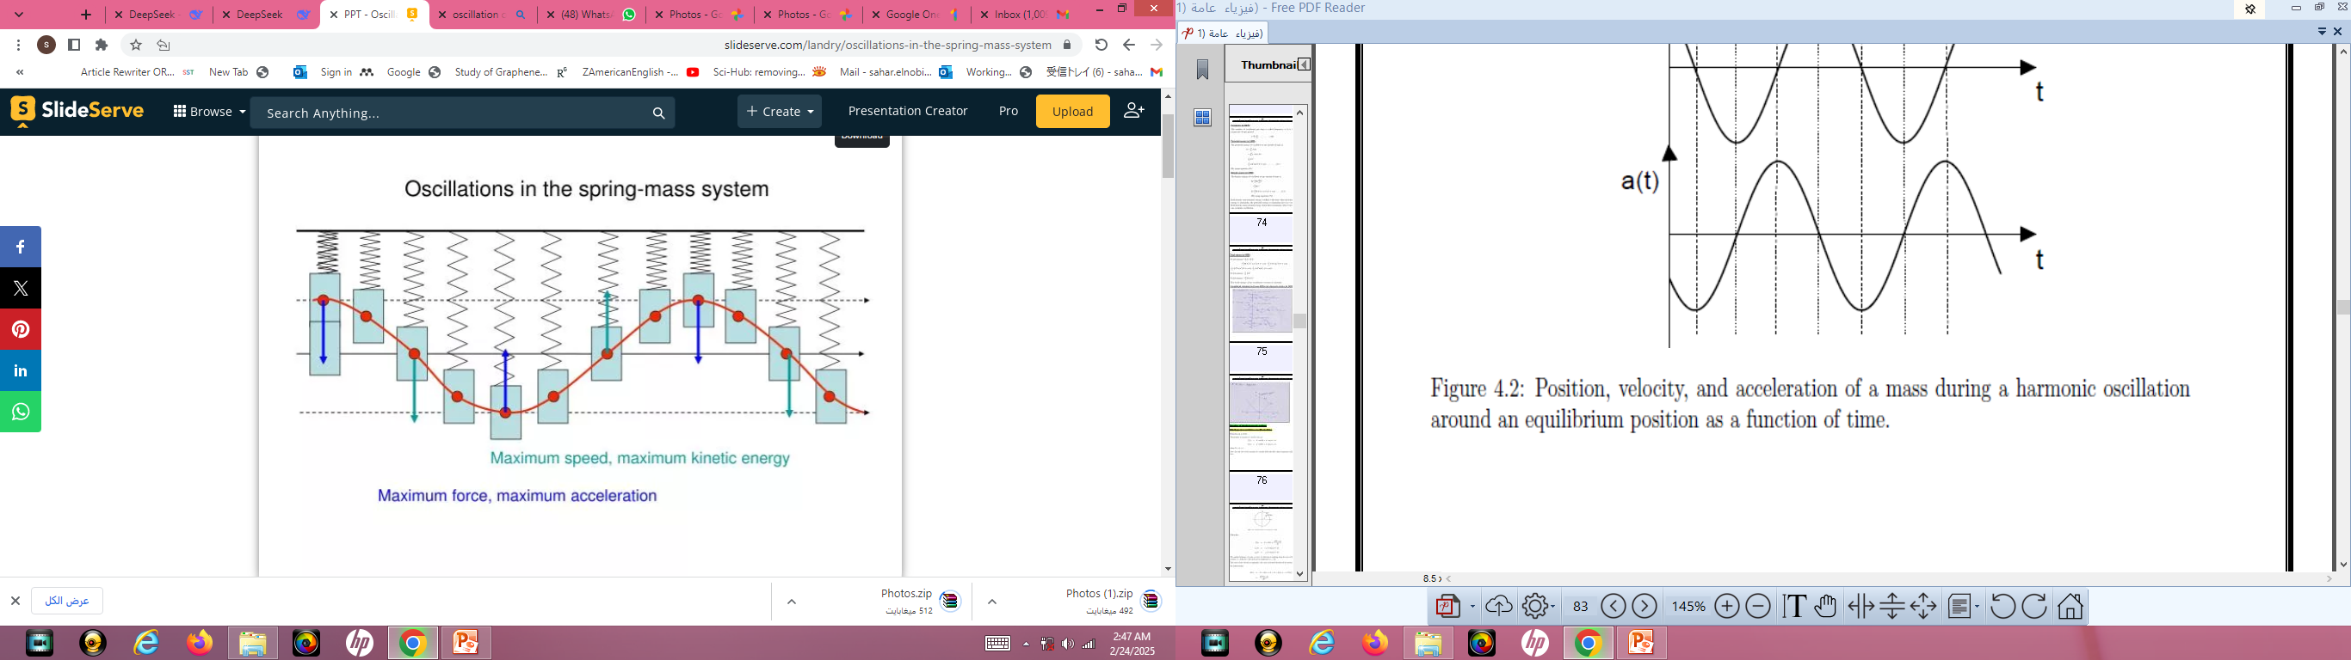
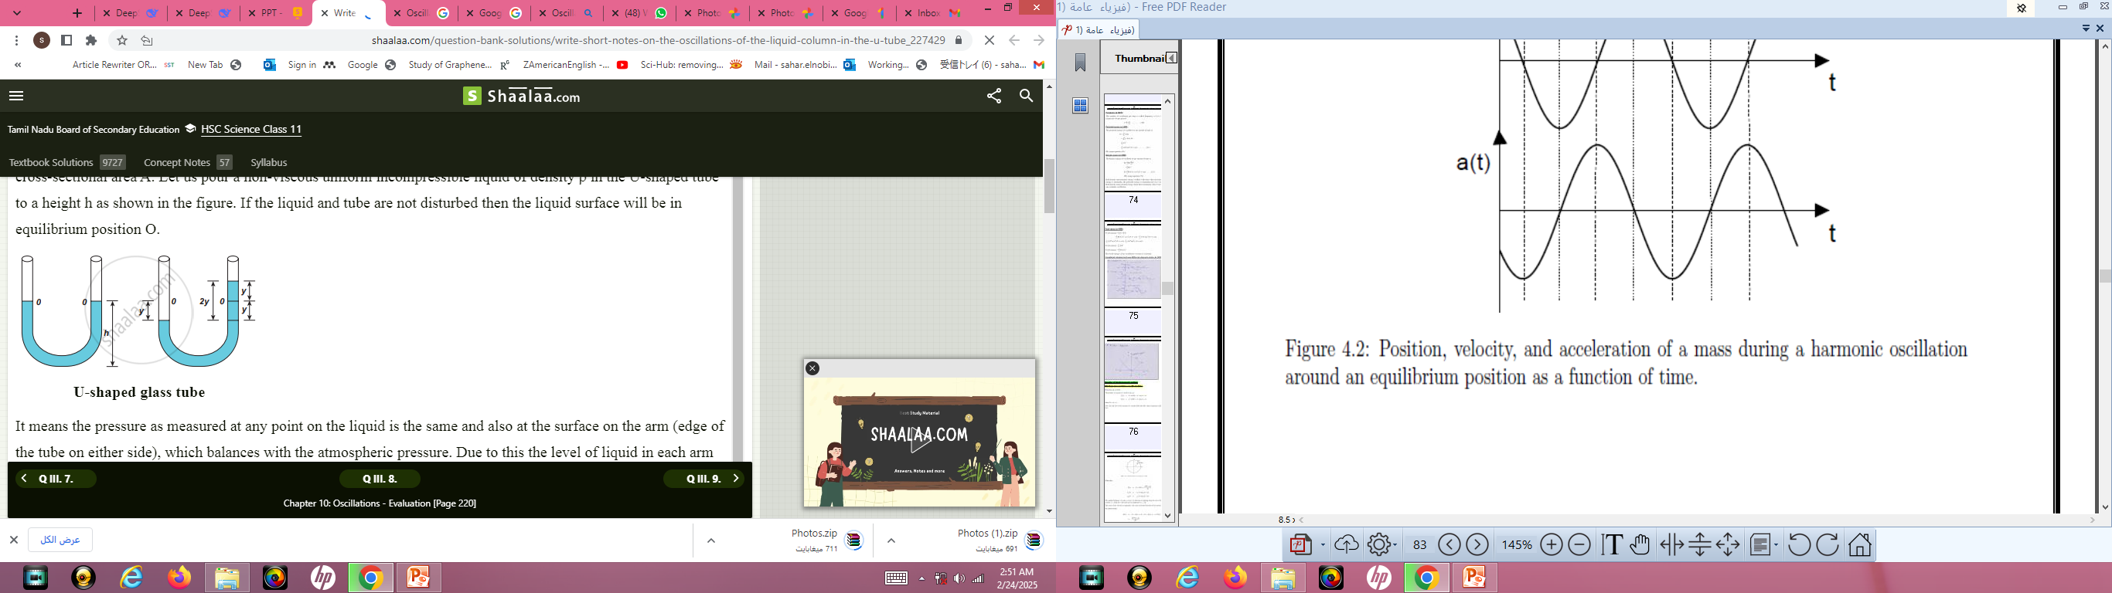
Types of oscillatory motion
It is of two types such as
Linear oscillation
Circular oscillation
Example of linear oscillation:-
1. Oscillation of mass spring system.
2. Oscillation of fluid column in a U-tube.

Slide 5
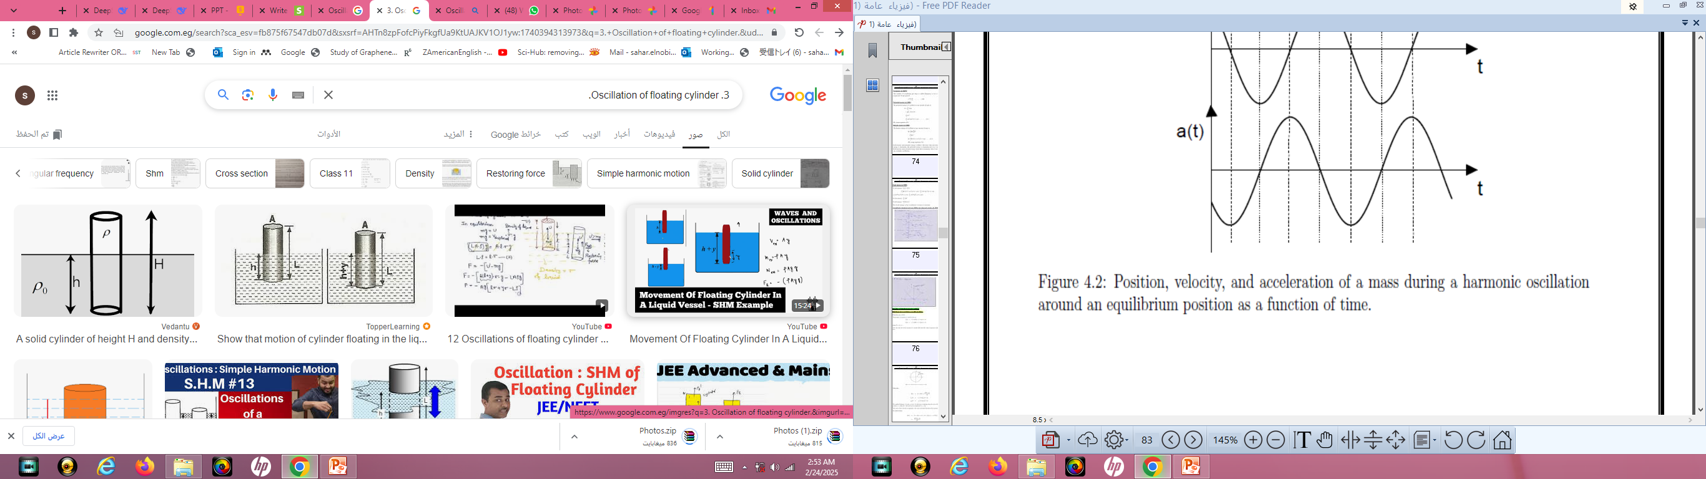
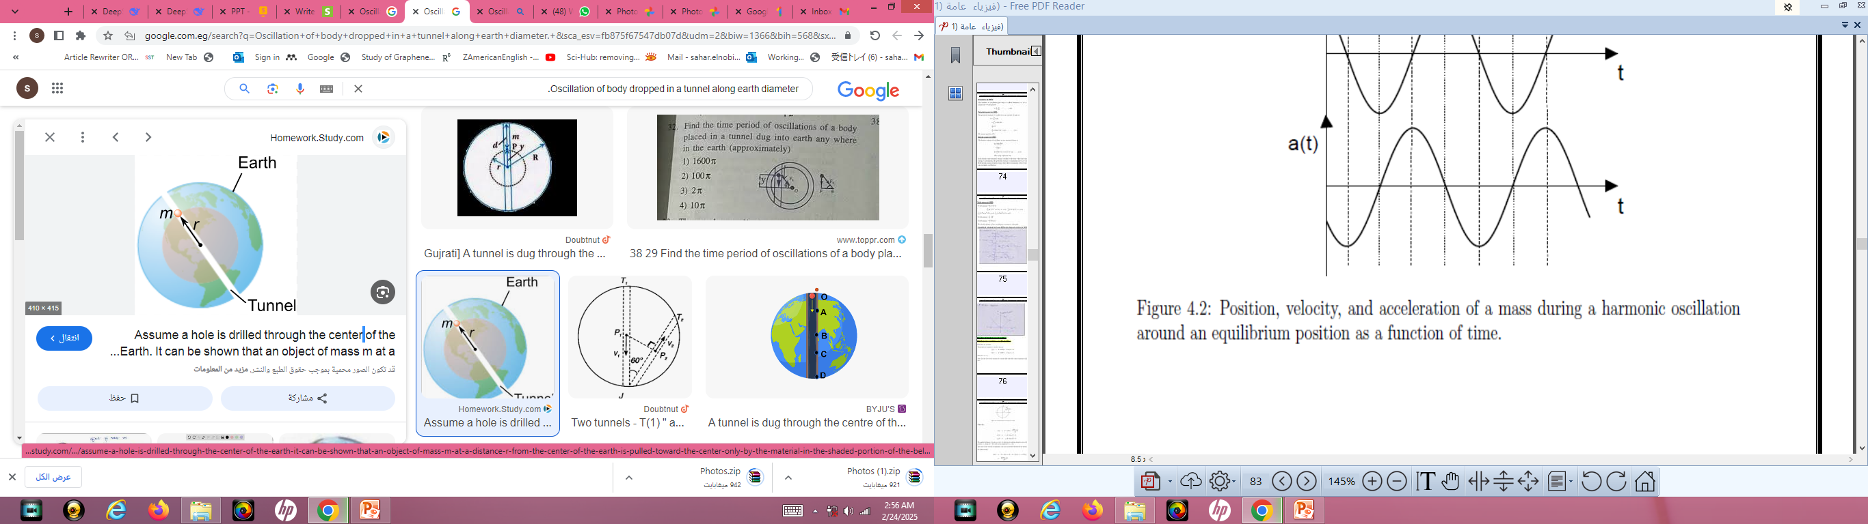
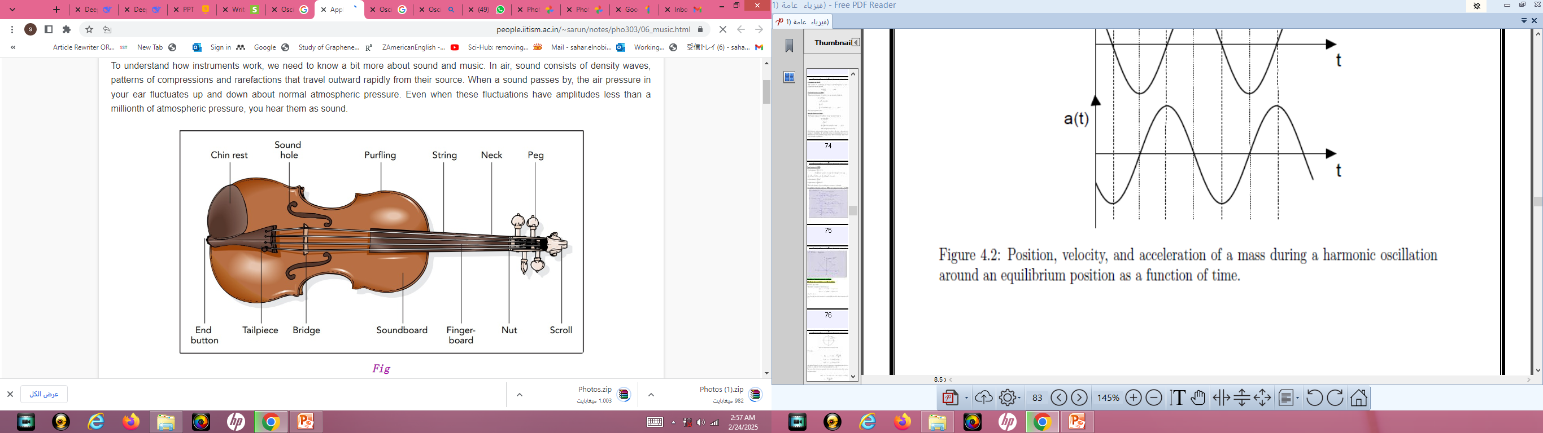
3.Oscillation of floating cylinder.
4. Oscillation of body dropped in a tunnel along earth diameter.
5. Oscillation of strings of musical instruments

Slide 6
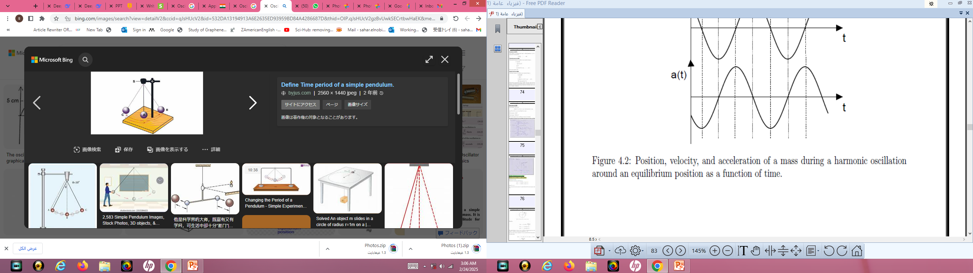
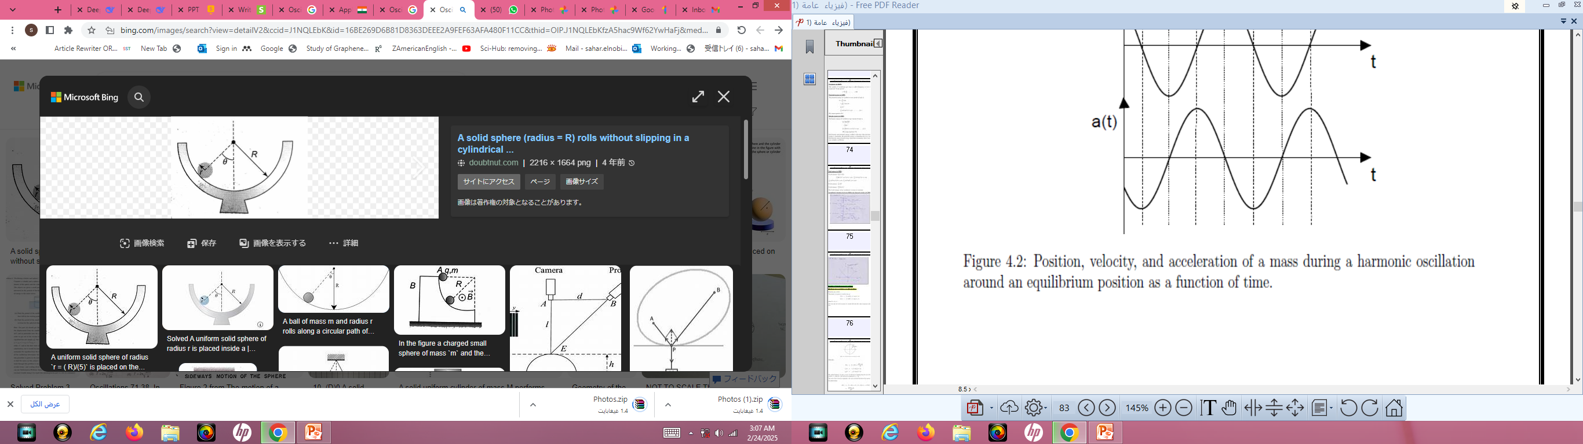
Example of circular oscillation
1. Oscillation of simple pendulum.
2. Oscillation of solid sphere in a cylinder (If solid sphere rolls without slipping).

Slide 7
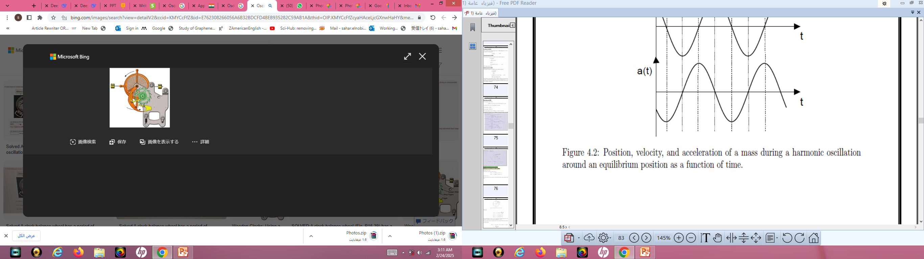
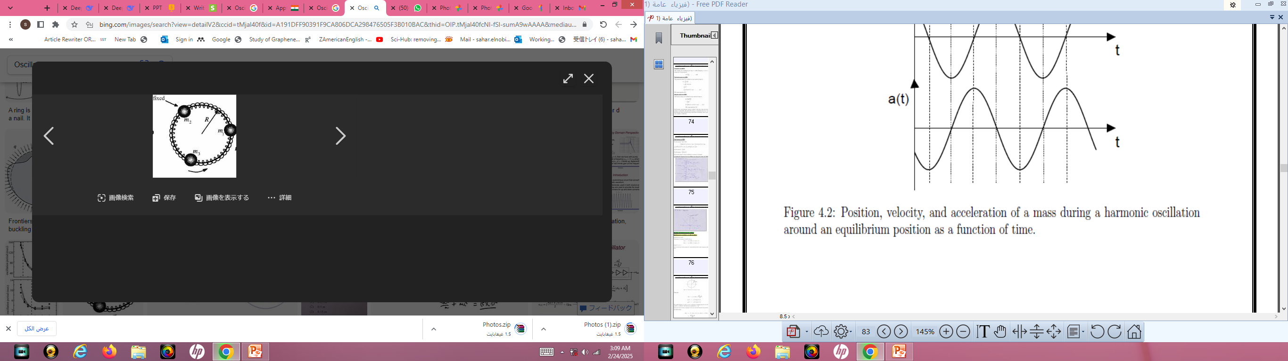
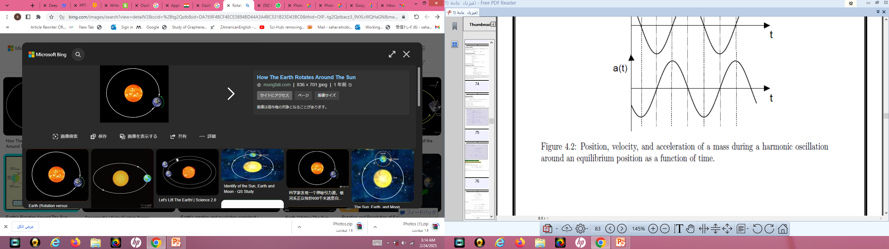
3. Oscillation of a circular ring suspended on a nail.
4. Oscillation of balance wheel of a clock.
5. Rotation of the earth around the sun.

Slide 8
Oscillatory system
The system in which the object exhibit to & fro motion about the equilibrium position with a restoring force is called oscillatory system.
2. Oscillatory system is of two types such as mechanical and non-mechanical system.

Slide 9
Non-mechanical oscillatory system
In this type of system, body itself doesn't change its position but its physical property varies periodically.
e.g:
The electric current in an oscillatory circuit.
The lamp of a body which is heated and cooled periodically.
The pressure in a gas through a medium in which sound propagates.
The electric and magnetic waves propagates undergoes oscillatory change.

